Slide 1

Chapter no. 6 (TEXT)

Slide 2

Group Members
Omar Baig (2024-GenAI-09)
Shahbaz Ali (2024-GenAI-07)
M. Nouman (2024-GenAI-08)
M. Faizan (2024-GenAI-)
Afzal Hussain (2024-GenAI-41)
Khuram Iqbal (2024-GenAI-43)

Slide 3

Introduction to Generative Models for Text Data
Overview of generative models for text data
Importance of understanding differences between text and image data

Slide 4

Key Differences Between Text and Image Data
Discrete vs. Continuous Data
Text: Discrete units
Challenge: Applying backpropagation to text
Temporal vs. Spatial Dimensions
Text: Time dimension, word order matters
Challenge: Capturing sequential dependencies
Sensitivity to Small Changes
Text: Highly sensitive, changes affect coherence
Images: Less sensitive to pixel changes
Challenge: Maintaining coherence in text generation

Slide 5

Key Differences Between Text and Image Data
Grammatical and Semantic Rules
Text: Strict grammatical and semantic rules
Images: No strict rules for pixel values
Challenge: Ensuring grammatical and semantic correctness

Slide 6

Progress and Ongoing Research
Significant advancements in text modeling
Continued research to address challenges\

Slide 7
The Literary Society for Troublesome Miscreants
Concept: Edward Sopp, a prison warden, uses inmates to generate stories
Outcome: Proficiency in generating realistic text

Slide 8

Recurrent Neural Networks
Structure: Recurrent layer allows past information to influence current predictions
Limitation: Simple tanh operator led to vanishing gradient problem

Slide 9

Introduction to LSTM Networks
Definition: a type of RNNs Recurrent Neural Network that can detain long-term dependencies in sequential data
Function: Incorporates past iwnformation into current predictions
Evolution: Overcame vanishing gradient problem in early RNNs
Adaptations: Variations like GRUs developed

Slide 10

Text Tokenization and LSTM Training for Word Prediction

Slide 11

Introduction
Topics Covered: Tokenization methods, dataset preparation, and LSTM model training

Slide 12
Introduction to Tokenization
Definition: Tokenization is the process of splitting text into individual units
Importance: Choice of tokenization affects text cleaning, model training, and output

Slide 13

Word Tokenization Overview
Lowercasing: Convert all text to lowercase
Vocabulary Size: Large vocabulary due to distinct words
Sparse Words: Replace infrequent words with an "unknown" token
Example
Original: "I love New York City."
Tokenized

Slide 14
Word Tokenization Considerations
Stemming: Reducing words to their root form
Example: "browsing", "browsed", "browses" -> "brows"
Punctuation Handling: Tokenize or remove punctuation
Vocabulary Limitation: Model cannot predict words outside training vocabulary

Slide 15

Character Tokenization Overview
Flexibility: Can generate new words outside training vocabulary
Vocabulary Size: Much smaller
Case Sensitivity: Decide whether to convert capital letters to lowercase

Slide 16
LSTM Architecture Overview

Slide 17
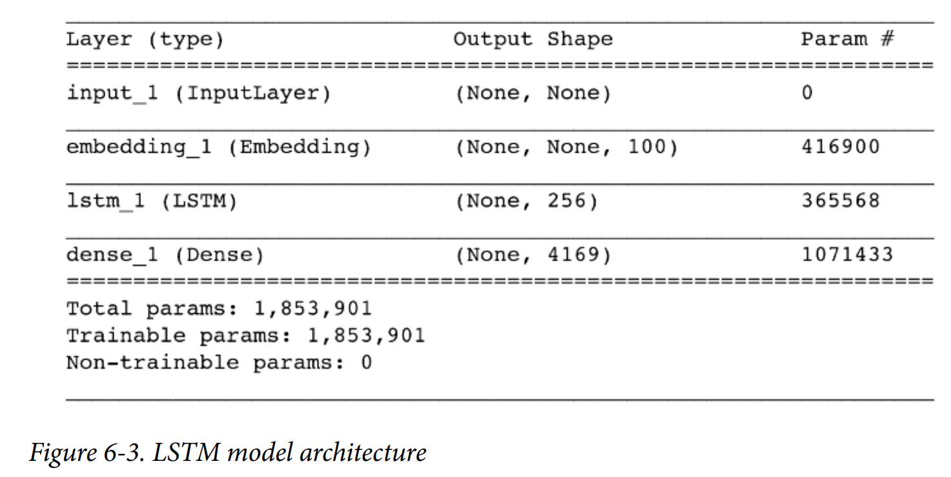
Overview
Input: Sequence of integer tokens
Output: Probability of each word in the vocabulary appearing next
Key Components: Embedding Layer, LSTM Layer

Slide 18
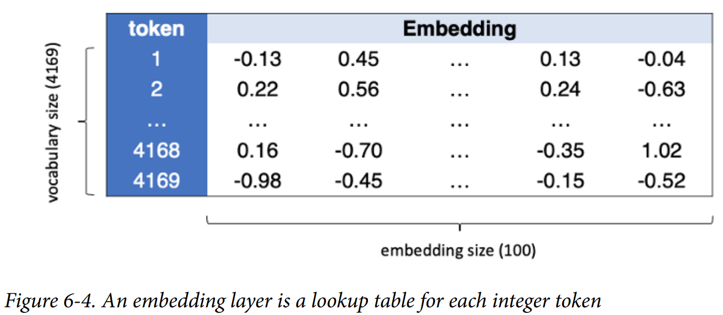
The Embedding Layer
Converts each token into a vector of length embedding_size

Slide 19
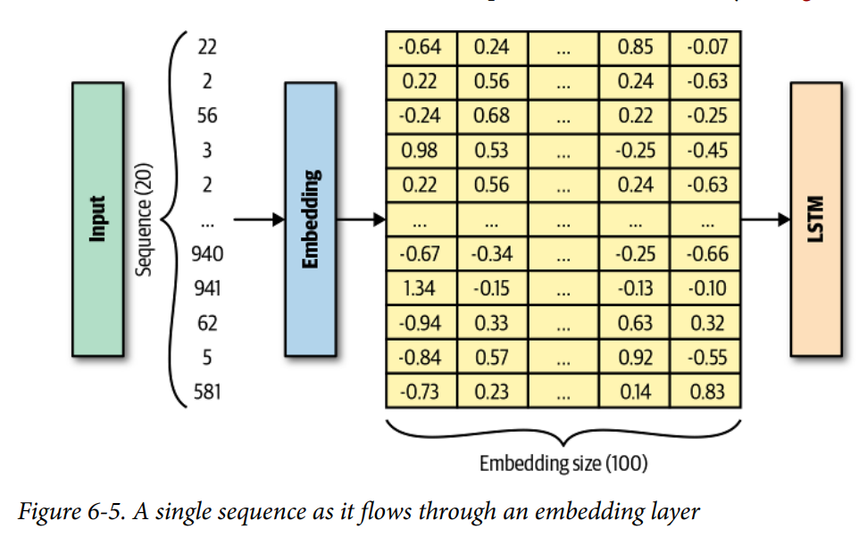
Weights
Number of weights = Size of vocabulary * embedding_size
Tensors
Input: [batch_size, seq_length]
Output: [batch_size, seq_length, embedding_size]

Slide 20
Purpose
Learn representations for each word through backpropagation

Slide 21
LSTM Layer

Slide 22
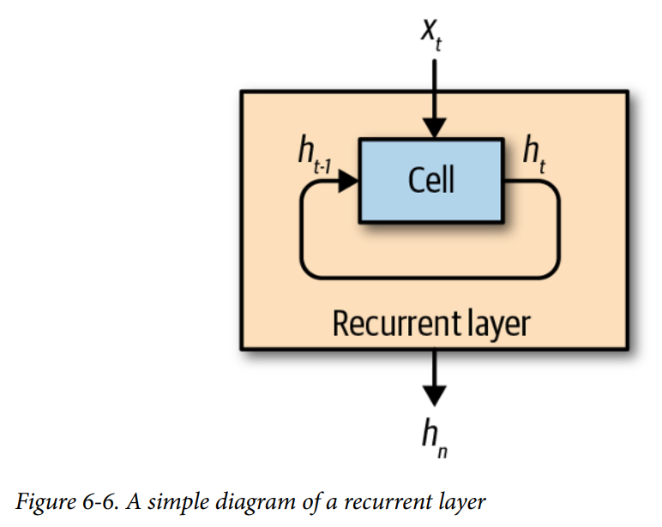
Title: The LSTM Layer
Processes sequential input data

Slide 23
Components
Cell: Updates its hidden state ht at each timestep t
Hidden State
Represents the cell’s current understanding of the sequence

Slide 24
Process
At timestep t, combines previous hidden state ht-1 and current input xt to update hidden state ht
Continues until end of sequence
Outputs final hidden state hn

Slide 25
Visualization of LSTM Process
Unrolling the sequence to show hidden state updates
Key Point
All cells share the same weights

Slide 26
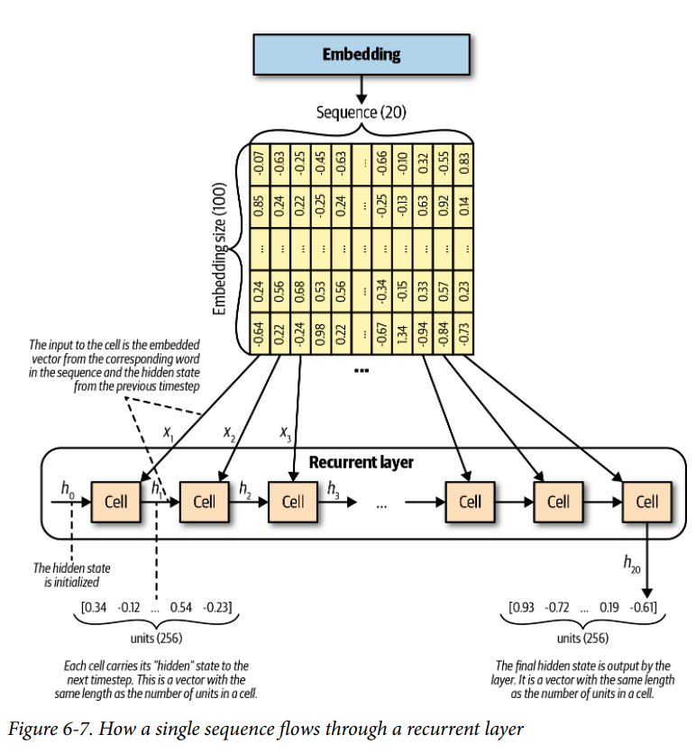
Diagram
Shows how previous hidden state blends with current data to produce next hidden state

Slide 27
Important Notes
Final hidden state is the output of the LSTM layer
All cells in the LSTM layer have identical weights
Can access hidden state at each timestep for further use

Slide 28

Generating Text with LSTM Networks

Slide 29

Introduction
Introduction
Content
Introduce LSTM networks as a type of recurrent neural network that can model sequences of data
Briefly explain the significance of text generation and its applications in areas such as creative writing, chatbots, and automated content creation

Slide 30

Process Overview
Text Generation Process
Content
Outline the step-by-step process for generating text
Feed the network with an initial sequence of words
Use the network to predict the next word
Append the predicted word to the sequence
Repeat the process to generate a longer string of text

Slide 31

Sampling with Temperature
Sampling with Temperature
Content
Explain the concept of sampling from the model's output probabilities
Introduce the temperature parameter
Low temperature More deterministic, less random choices
High temperature More random, diverse choices
Mention that temperature helps control the creativity and coherence of generated text

Slide 32
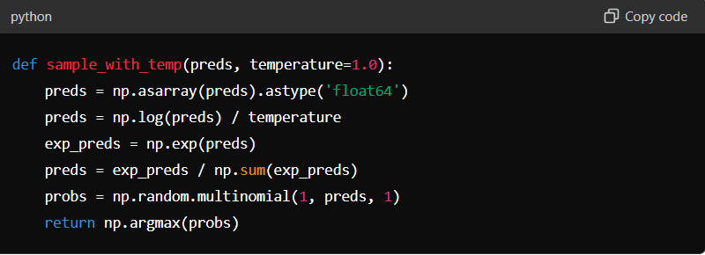
Example Code - Sampling Function

Slide 33
Text Generation Function
Text Generation Function
Content
Describe the generate_text function that uses the LSTM model to generate text
Explain the steps involved
Convert the seed text to a sequence of tokens
Predict the next word using the model
Append the predicted word to the seed text
Repeat the process to generate the desired number of words

Slide 34
Example Code - Text Generation
Example Code Text Generation
Content
Present the generate_text function in Python

Slide 35
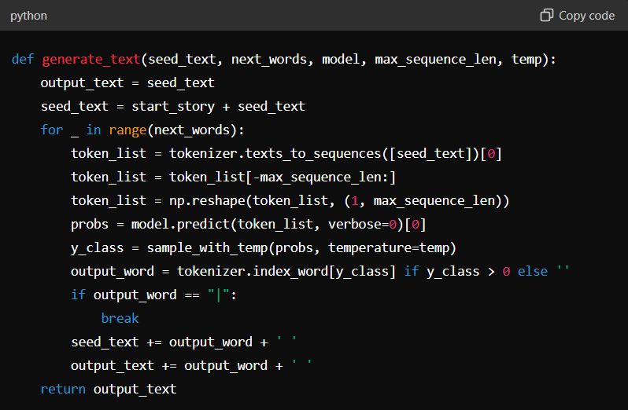

Slide 36
Temperature Impact
Impact of Temperature on Generation
Content
Discuss the effect of temperature on text generation
Low Temperature Generates text that is less adventurous but more coherent
High Temperature Generates text that is more diverse but less coherent
Provide examples to illustrate these differences

Slide 37
Examples of Generated Text
Examples of Generated Text
Content
Show passages generated at different temperatures
Highlight how lower temperatures produce safer, more predictable text, while higher temperatures produce more creative but sometimes nonsensical text

Slide 38
Human-Assisted Text Generation
Human-Assisted Text Generation
Content
Explain the concept of human-assisted text generation
The model suggests the top 10 words with the highest probabilities
A human selects the most appropriate word from the list
Compare this approach to predictive text on mobile devices

Slide 39

Probability Distributions
Word Probability Distributions
Content
Show examples of word probability distributions following various sequences
Discuss how the model learns context and grammatical correctness even without explicit rules

Slide 40

Conclusion
Conclusion
Content
Summarize the process of generating text using LSTM networks
Highlight the importance of temperature in controlling text generation
Mention potential applications and future directions for improving text generation models

